Slide 1
“ottonova” JavaScript Coding Challenge with Bonus Task
By
Rizwan Mushtaq
October, 16 2021

Slide 2
Content
Technologies Used
How to Start an Application
Application – Project Structure
Further Project Extension
Application - Login Page
Application - App Page
Module - Complete
Module - Date
Module - Map
Module – Rate
Module - Rate : User Response
Application - End Page
Thanks you

Slide 3
Technologies Used
Technology Used to develop Application are following:
React.js
Functional Components are used
React Hooks are used
JavaScript
Promise Feature is used
Sass
Styles have been applied to each component using separate “.module.scss” files.

Slide 4
How to Start an Application
Steps to Run Project:
1) Open Project in any Code editor like VS Code
2) Open Terminal
3) Go to directory of Project
4) Run command: “npm start”
-> App will run in Browser and Login Page will appear in Viewer.
Login User:
username = admin
password = admin

Slide 5
Application – Project Structure
src
App.js
Index.js
Images
Components
AppPage.jsx
EndPage.jsx
LoginPage.jsx
command_components
CompleteComponent.jsx
DateComponent.jsx
MapComponent.jsx
RateComponent.jsx
command_socket.js

Slide 6
Further Project Extension
How to add new Project Features:
As per requirements project could be extended by adding more functional components and integrating new components in Application.

Slide 7
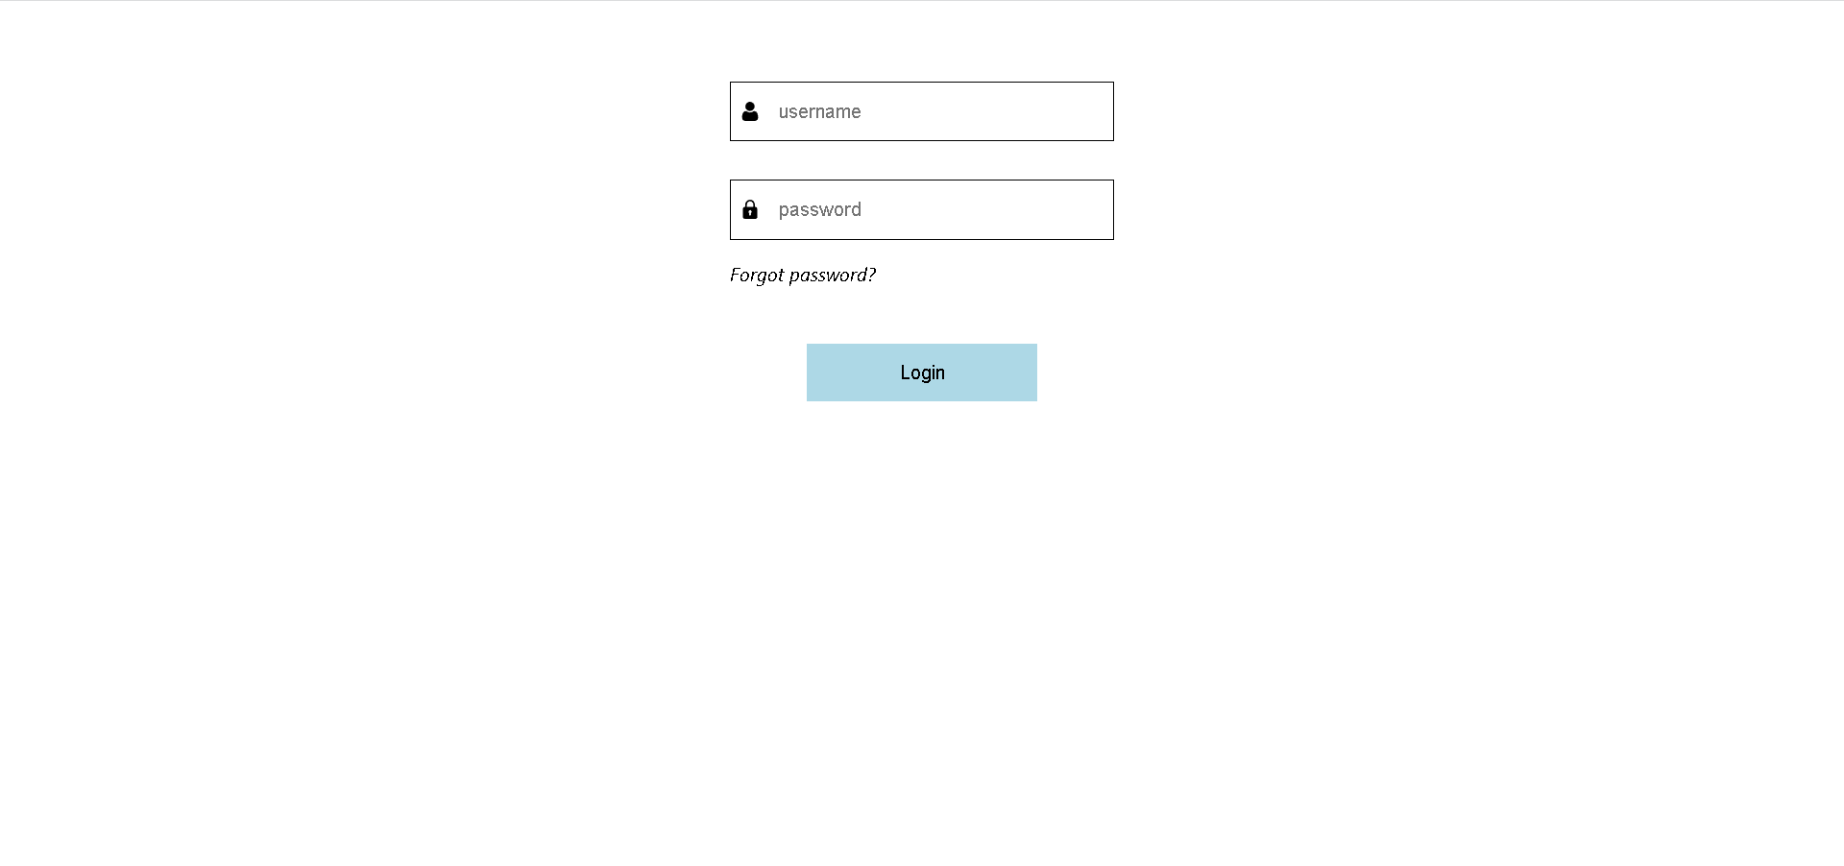
Application - Login Page
Run command “npm start”
Application loads in browser
Login Page is visible
Use following details to login:
username = admin
password = admin

Slide 8
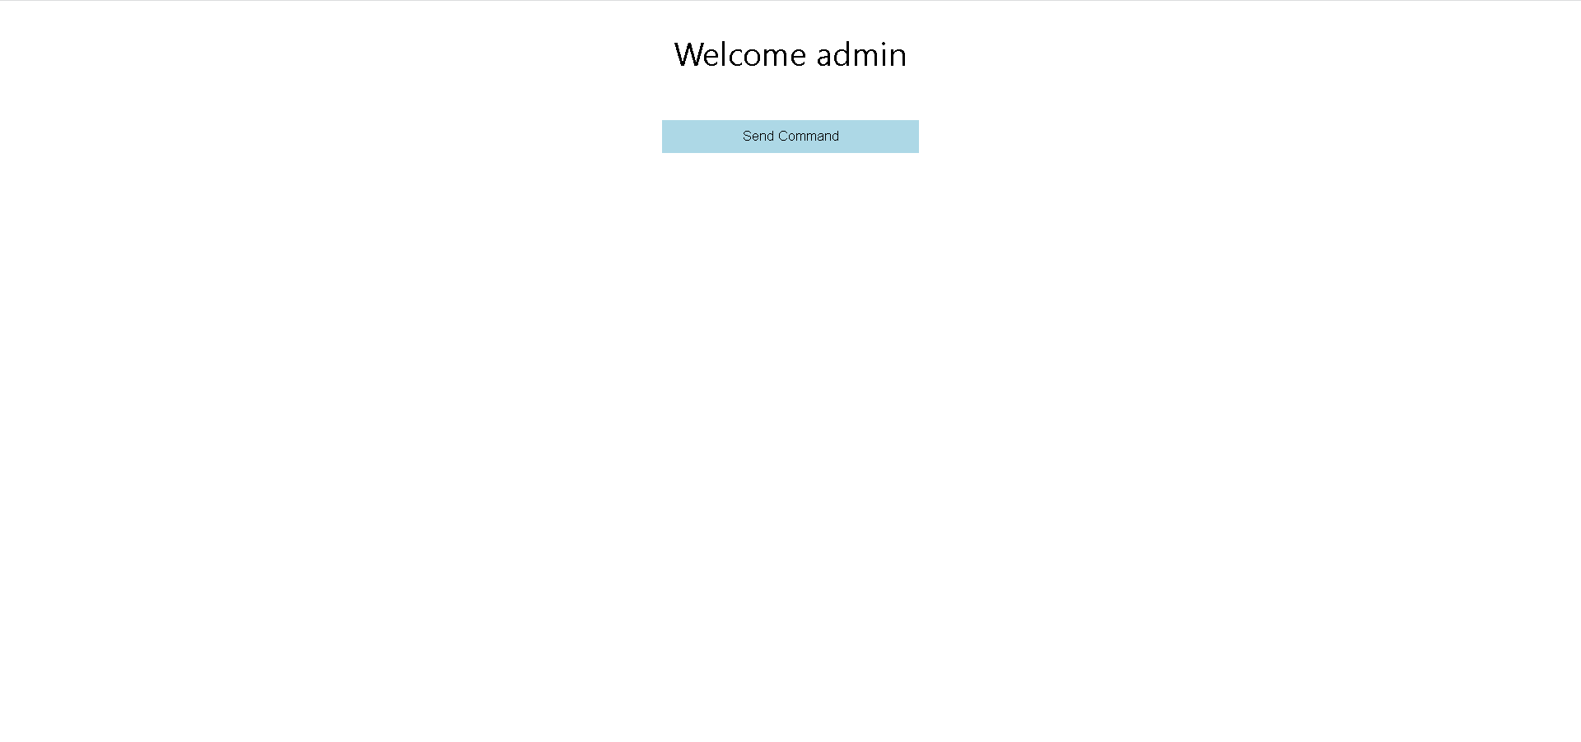
Application - App Page
On successful login, App Page will appear
Click on button to send command to backend

Slide 9
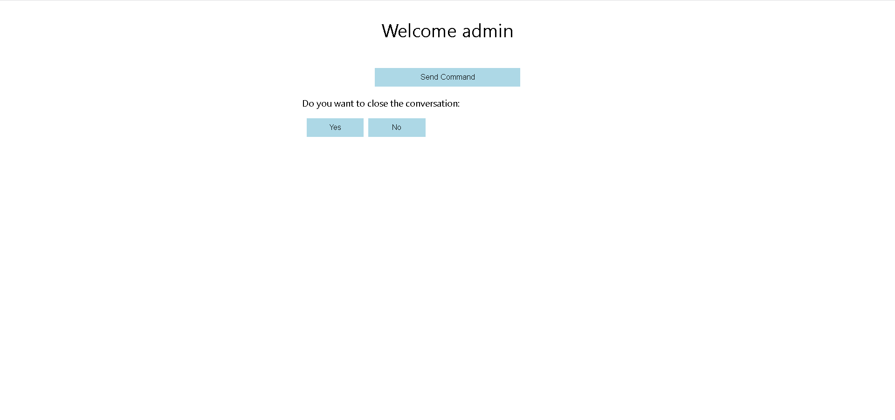
Module - Complete
If Backend responds with command of type: complete, following screen will appear as following:

Slide 10
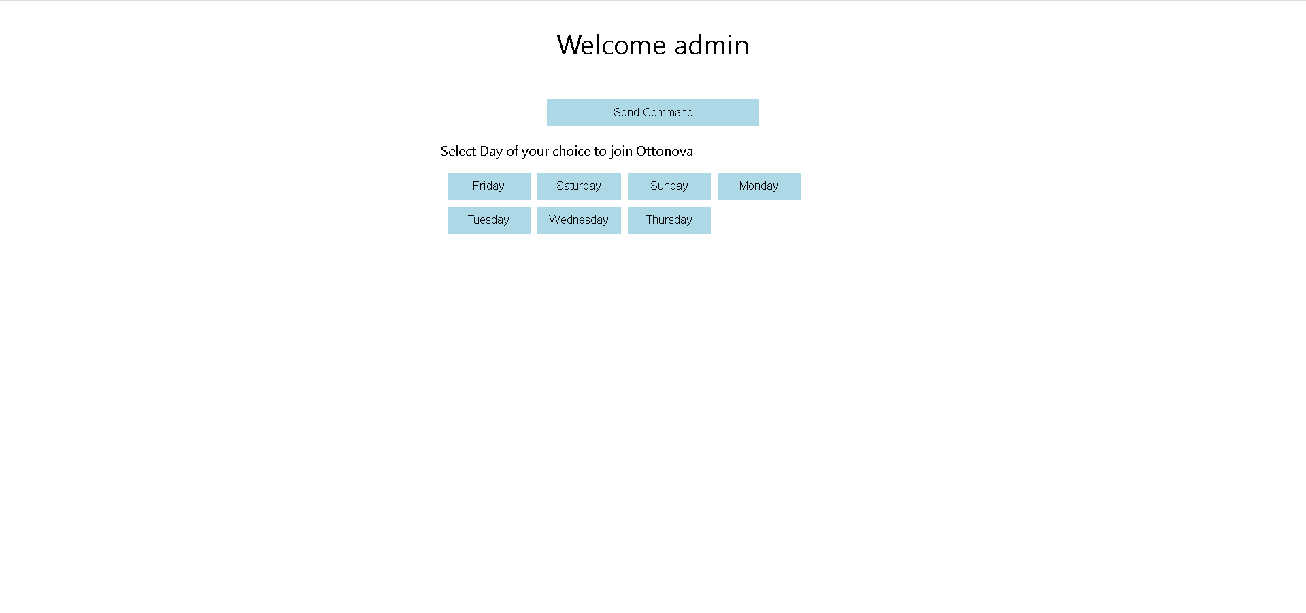
Module - Date
If Backend responds with command of type: date, following screen will appear as following:

Slide 11
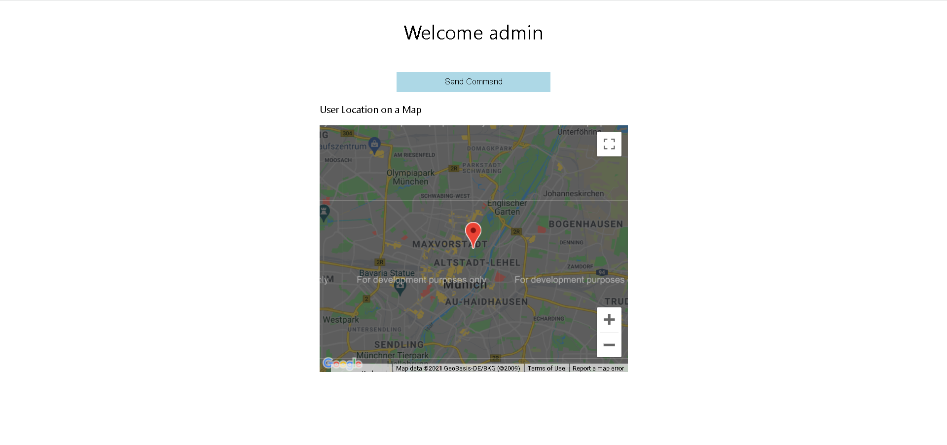
Module - Map
If Backend responds with command of type: map, following screen will appear as following:

Slide 12
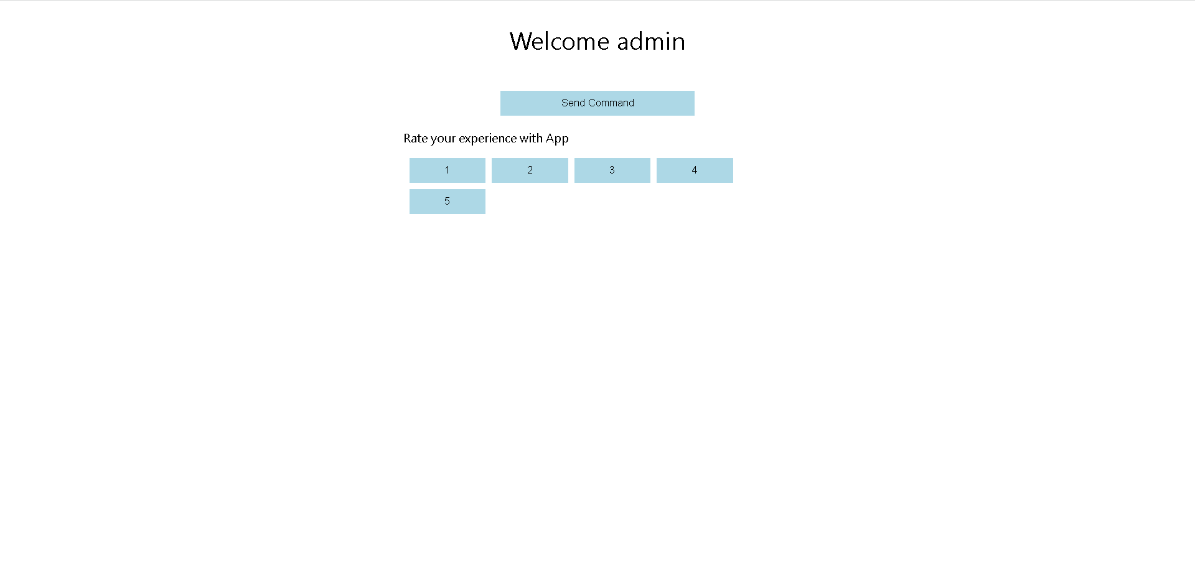
Module - Rate
If Backend responds with command of type: rate, following screen will appear as following:

Slide 13
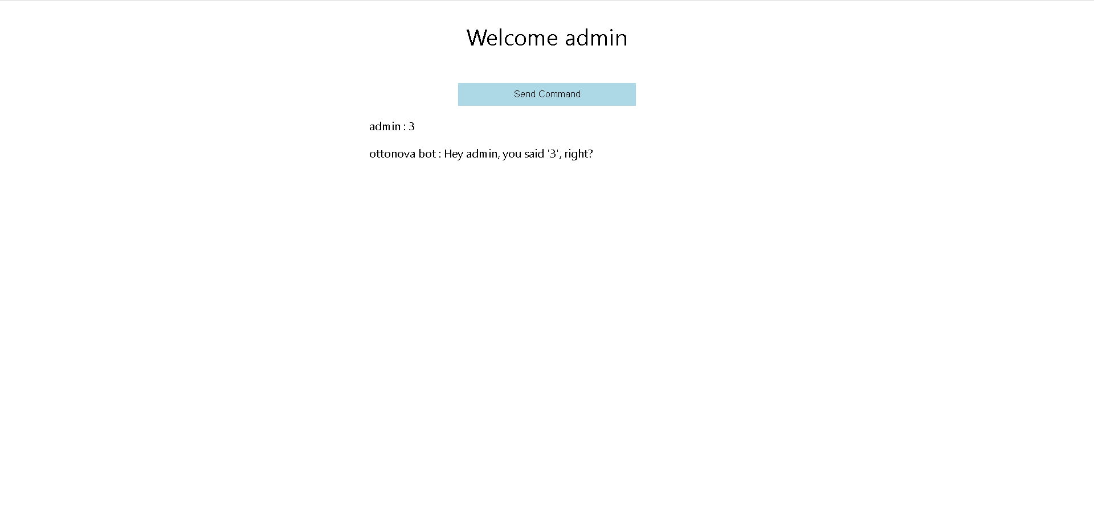
Module - Rate : User Response
If user rates an application and click on button “3”, following screen will appear:

Slide 14
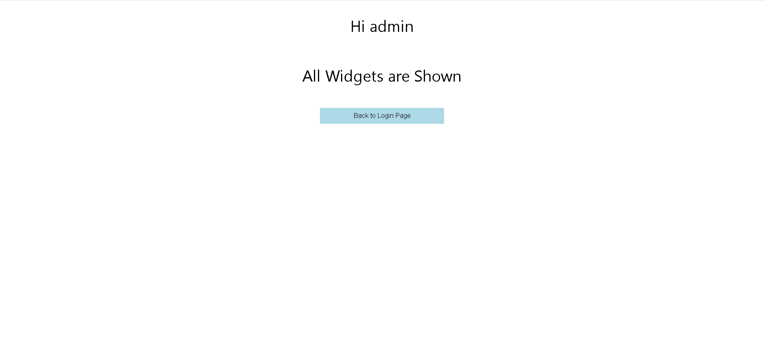
Application - End Page
When all four modules have been viewed, End Page will be visible as following:

Slide 15
Thank you for your time and consideration

